Slide 1
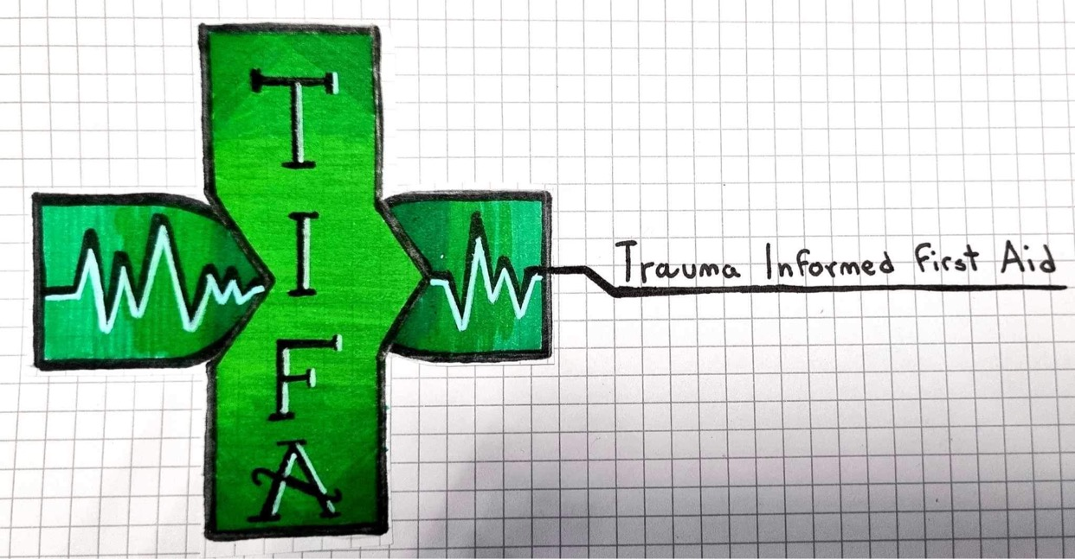


Applying Intentional Peer Support principles to
Trauma Informed First Aid
Catherine Arnold
Notes:
A relational approach to supporting bystanders after traumatic First Aid events.
Intentional Peer Support (IPS) principles can inform:
Bystander follow-up pathways
Trauma-informed First Aid training
Post-traumatic wellbeing

Slide 2
What is Intentional Peer Support ?
Intentional Peer Support (IPS) is a framework for building transformative, mutual relationships where people with shared experiences learn and grow together
IPS was founded by Shery Mead, drawing on her lived and learnt experience in the 1990s
IPS shifts from a traditional "helper/helpee" dynamic to partnerships focused on new perspectives, self-awareness, and moving towards what people want, rather than fixing problems.
It emphasizes asking "what happened?" instead of "what's wrong?", using shared understanding (lived experience) to create hope, and fostering community-based change

Slide 3
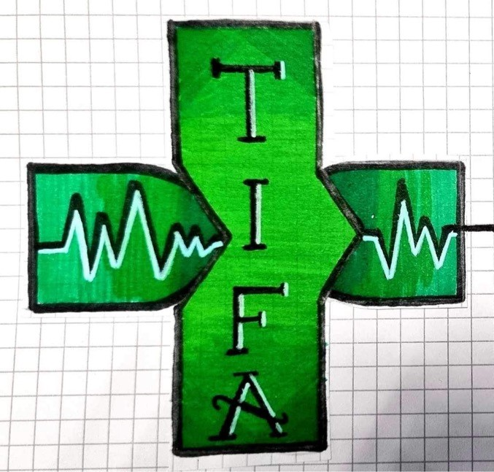
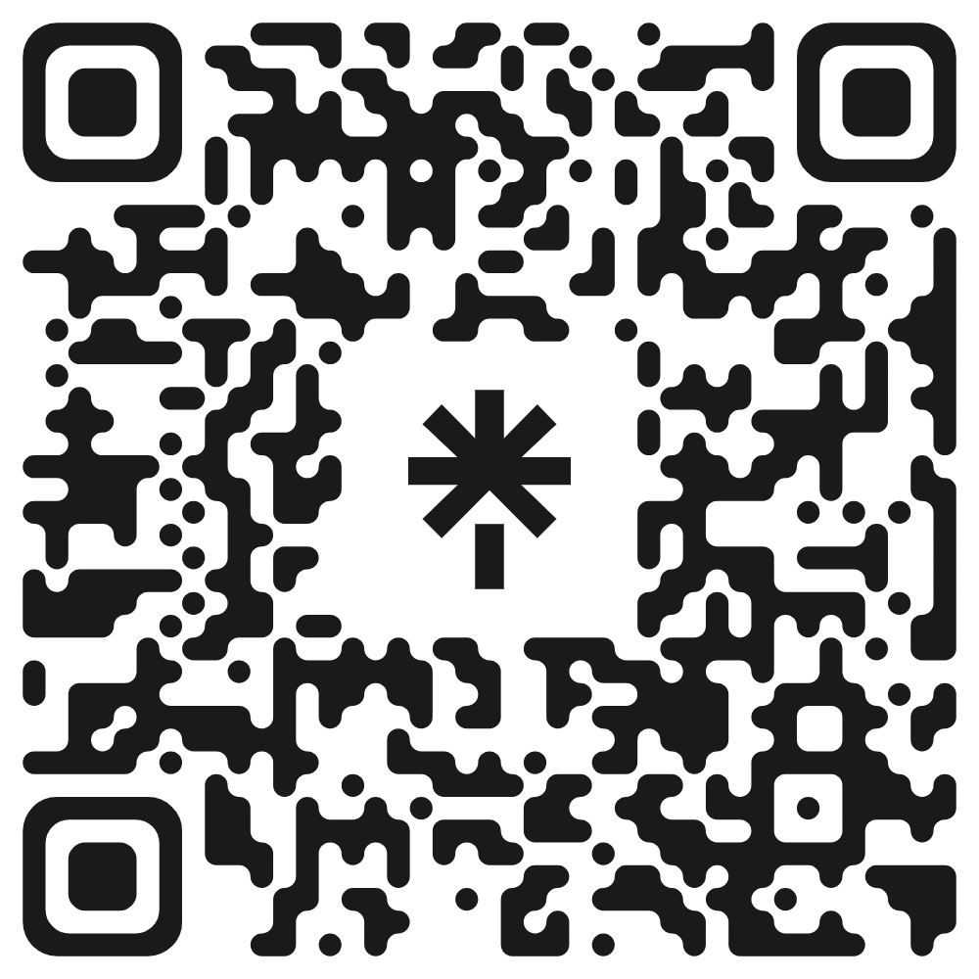
What is Trauma Informed First Aid?
Trauma Informed First Aid (TIFA) aims to support members of the public who have witnessed or helped at a serious emergency like a cardiac arrest or road traffic collision
Whereas professional responders can access Trauma Risk Management (TRiM) Peer Support, there are limited options to support members of the public
In this presentation, I have applied the IPS principles to the TIFA context.
For more info, see: https://linktr.ee/traumainformedfirstaid

Slide 4
From Individual to Relationship
IPS shifts the focus from isolated individual problems to the relational context where meaning and change can develop.
Reframing the social contract and community’s post-incident duty of care for First Aiders
Encourages relational safety and support from trainers or peer groups with similar lived experiences
Help First Aiders to feel less isolated in their reactions to a traumatic incident, e.g. freezing up
Notes:
From Individual to Relationship
IPS shifts the focus from isolated individual problems to the relational context where meaning and change can develop.
- Reframing the social contract and community’s post-incident duty of care for First Aiders
- Encourages relational safety and support from trainers or peer groups with similar lived experiences
- Help First Aiders to feel less isolated in their reactions to trauma, including freeze responses

Slide 5
From Helping to Learning Together
Instead of trying to “fix” someone, IPS focuses on exploring experiences to create new understanding and possibilities.
Exploring ‘what happened’, including the body and mind’s natural reactions to a traumatic emergency
Rebuilding confidence through re-engaging with First Aid skills and building back capacity together.
Reframing and creating shared narratives focusing on helpful actions rather than dwelling on ‘what if’s
Notes:
From Helping to Learning Together
Instead of trying to “fix” someone, IPS focuses on exploring experiences to create new understanding and possibilities
- Exploring ‘what happened’, including the body and mind’s natural reactions to trauma
- Reframing kind intentions and helpful actions; not dwelling on ‘what if’s
Rebuilding confidence through re-engaging with First Aid skills and building back capacity together.
Focus on ensuring a safe environment for vulnerability and growth, rather than assessing competency

Slide 6
From Fear to Hope & Possibility
IPS moves us away from fear-driven reactions toward a shared sense of hope, choice, and future possibilities.
Doesn’t pathologise natural reactions to trauma
Build hope, agency and self-belief through gradual re-engagement with First Aid skills
Help to increase the likelihood of someone being willing as well as able to help again in a future emergency
Notes:
From Fear to Hope & Possibility
IPS moves us away from fear-driven reactions toward a shared sense of hope, choice, and future possibilities.
- Build hope, agency and self-belief through gradual re-engagement with First Aid
- Focus on ensuring a safe environment for vulnerability and growth, rather than assessing competency
- Help to increase the likelihood of someone being willing as well as able to help again in a future emergency

Slide 7
Mutuality & Connection
IPS prioritises authentic human connection as the foundation for emotional safety, trust, and healing & emphasises continuous learning and growing together
Peer-support spaces validate the emotional, physical and psychological aftermath of emergencies
Connection and shared reframed narratives reduce blame, shame and ‘what if’s?’
Focus on creating a safe environment for vulnerability and growth, rather than assessing competency

Slide 8
Worldview & Moving Towards
IPS recognises that each person’s experiences shape how we see the world and supports people in identifying what matters to them and taking small, intentional steps towards that
Discussing trauma reactions can help First Aiders understand why they responded in a certain way during an emergency (e.g. freezing)
Peer Support helps establish post-traumatic wellbeing, integrate new meaning and rebuild identity
This provides a safe foundation for rebuilding First Aid skills, and promotes willingness to help

Slide 9
Summary & Implications for Practice
Intentional Peer Support (IPS) principles can inform:
  Bystander follow-up pathways
  Trauma-informed First Aid training
  Post-traumatic wellbeing
IPS strengthens First Aid education by:
  Building safe, relational spaces
  Reducing fear and shame
  Supporting growth and renewed confidence
Notes:
Intentional Peer Support (IPS) principles shape my understanding of trauma-informed First Aid by emphasising relationships over rescue, learning over fixing, and possibility over fear. IPS reframes post-traumatic conversations with bystanders as shared, collaborative processes rather than clinical interventions. It highlights the importance of connection, helping individuals feel less isolated in their reactions, and acknowledges how traumatic incidents can disrupt a person’s worldview, confidence, and sense of safety. Through mutuality, IPS values lived experience alongside professional expertise, ensuring support feels equal, validating, and empowering rather than hierarchical. Finally, the principle of moving towards guides supportive conversations toward growth, renewed capability, and re-engagement with First Aid skills in ways that feel safe and achievable. Together, these principles create a compassionate, relational foundation for helping trauma-affected First Aiders rebuild confidence, meaning, and readiness to respond again.

